Slide 1
Tumor Detection using AI
By : Aryan Jadhav
Soham Bhosage
Ganraj Kendre
Varnan Dhondage

Slide 2
Contents
1. | Introduction
2. | Need of Project
3. | Problem definition
4. | Proposed methodology
5. | System Architecture
6. | Resources Required
7. | ER Diagram
8. | Use Case Diagram
9. | Activity Diagram
10. | DFD Diagram

Slide 3
INTRODUCTION
Cancer is the leading cause of death in the world today
We have proposed a methodology to detect cancer using AI
This system will help the radiologists to detect cancer more reliably
In this system we analyse the data input by user and the system will give us a conclusion if the given tumor is malicious or benign.
The data given by user is in the form of image or in the form of textual reports.

Slide 4
NEED OF PROJECT
AI can “see” things that we humans can’t, and can find complex patterns and relationships between very different kinds of data.
The accuracy of AI is reliable enough to be implemented in real life.
AI can be more reliable when it comes to identifying if a tumor is cancerous or not.
This can help radiologists with the identification of tumors.
This can also help the doctors, as AI can help to identify some specific features or symptoms of the tumor.
This can further help doctors to learn about Cancer.

Slide 5
PROBLEM DEFINITION
Cancer is the leading cause of death in the world.
This disease is characterized by the development of abnormal cells that divide uncontrollably and the ability to infiltrate and destroy normal body tissue
Some general signs and symptoms associated with, but not specific to, cancer, include:
Fatigue.
Lump or area of thickening that can be felt under the skin.
Weight changes, including unintended loss or gain.
Changes in bowel or bladder habits

Slide 6
PROPOSED METHODOLOGY
The technique used for making this model work is Neural Network The different stages by which a Neural Network is applied to the dataset are:
Import the required packages
Import the data sets
Image reading is done after that it is labeled (such as 0 for benign and 1 for malicious) and then the reports are stored in the data frame.
The training sets are designed in a way that the AI algorithm learns from the training sets
The Accuracy of the System is evaluated
The loss graph and the accuracy graph are plotted.

Slide 7
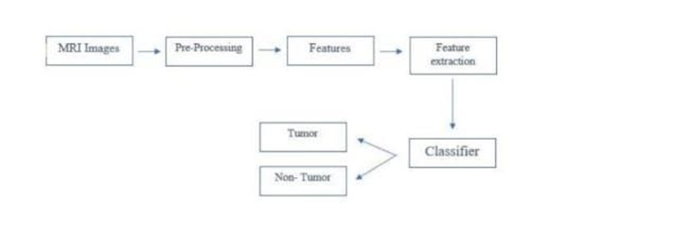
System Architecture

Slide 8
RESOURCES REQUIRED
RAM | 8GB
HARD DISK | 40GB
KEY BOARD | Standard windows keyboard
MOUSE | Two or three button mouse
MONITOR | LCD/LED
OPERATING SYSTEM | WINDOWS 11
CODING LANGUAGE | PYTHON
EDITOR | PYCHARM OR VS CODE

Slide 9
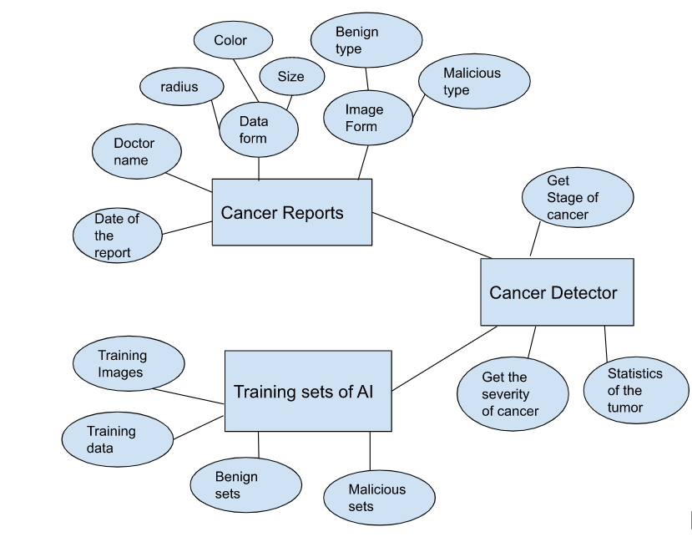
ER DIAGRAM

Slide 10
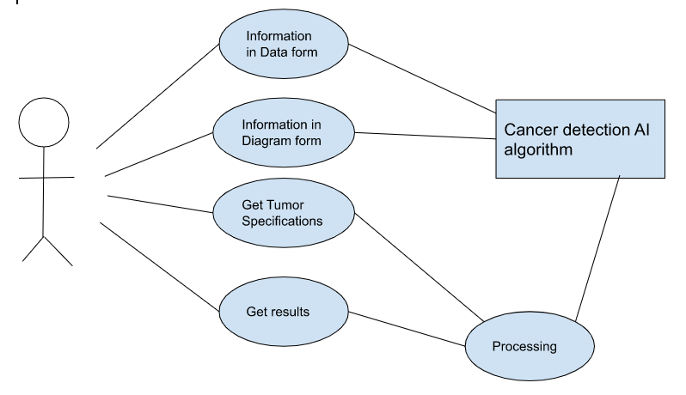
USE CASE DIAGRAM

Slide 11
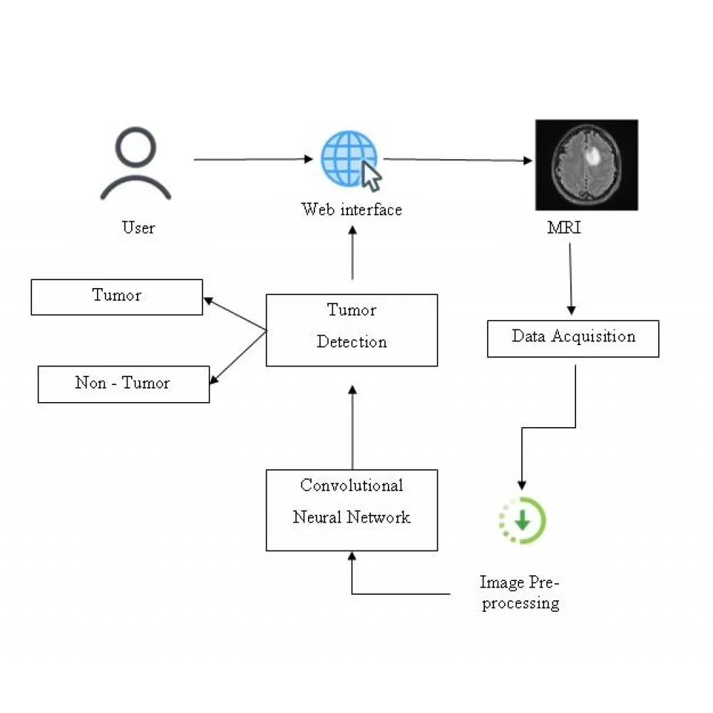
ACTIVITY DIAGRAM

Slide 12
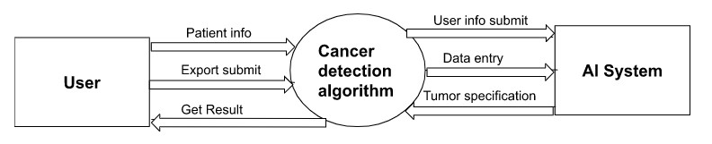
DFD DIAGRAM: LEVEL 0

Slide 13
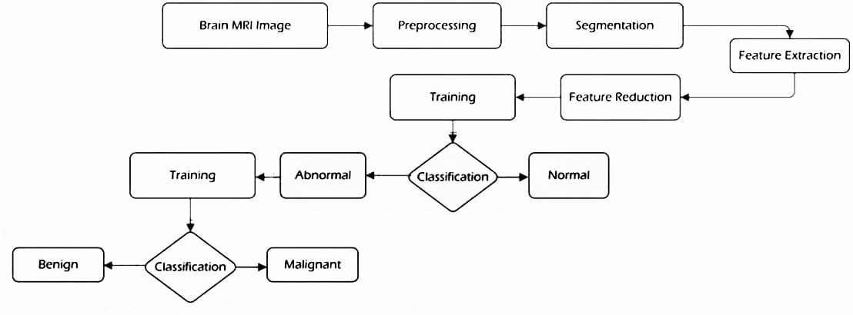
DFD DIAGRAM: Level 1

Slide 14


